Slide 1
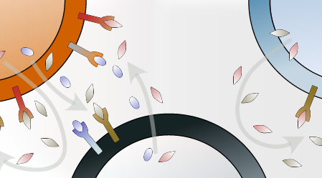
Introduction
Analysis & Results
Future work
Conclusion
BESE394 Final
Exploring Cell-to-Cell Interactions (CCI) Within GABAergic Interneurons During Development
Ali Balubaid, Ana Cecilia, Azari Bantan, Daniel Soto
Cell2Cell interactions

Slide 2
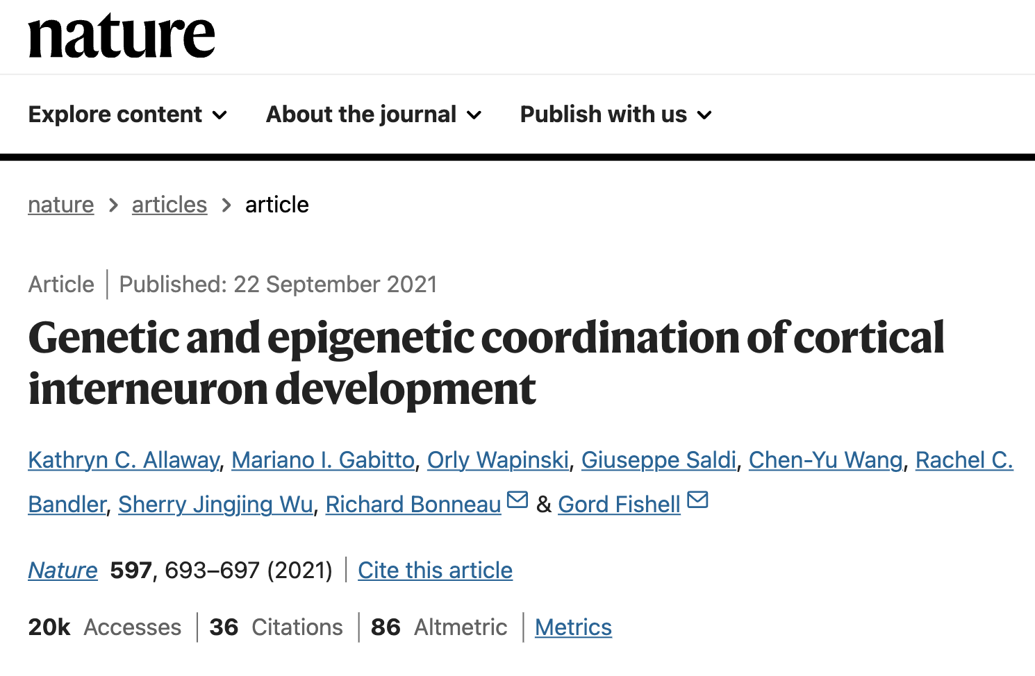

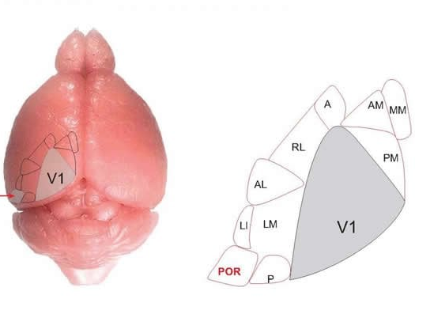



Introduction
Analysis & Results
Future work
Conclusion
Dataset
Source name: Cortex-V1
Organism : Mus musculus
Characteristics cell type: Cortical interneurons
Age: P10
Sample: GSM5014306
Source name: Cortex-V1
Organism : Mus musculus
Characteristics cell type: Cortical interneurons
Age: P28
Sample: GSM5014308
P10
P28
scRNA-seq
scRNA-seq
Questions ?
Lamp5
GABAergic
(inhibitory)
Pvalb
Vip
SST
Diverse interneurons
A
The interaction profiles between sub-types of GABAergic inhibitory neurons using single-cell transcriptomics
Glutamatergic
(excitatory)
Non-Neuronal
B
The behavior of interactions during development

Slide 3
Introduction
Analysis & Results
Future work
Conclusion
Why & how study cell2cell Communications (CCC)?

Slide 4
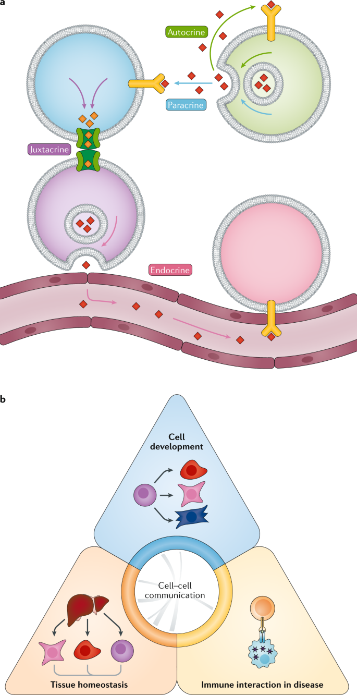

Introduction
Analysis & Results
Future work
Conclusion
Why & how study cell2cell Communications (CCC)?
Armingol et al. Nat Rev Genet. (2021)
Notes:
https://www.nature.com/articles/s41576-020-00292-x

Slide 5

Introduction
Analysis & Results
Future work
Conclusion
Why & how study cell2cell Communications (CCC)?
Armingol et al. Nat Rev Genet. (2021)
Notes:
https://www.nature.com/articles/s41576-020-00292-x

Slide 6
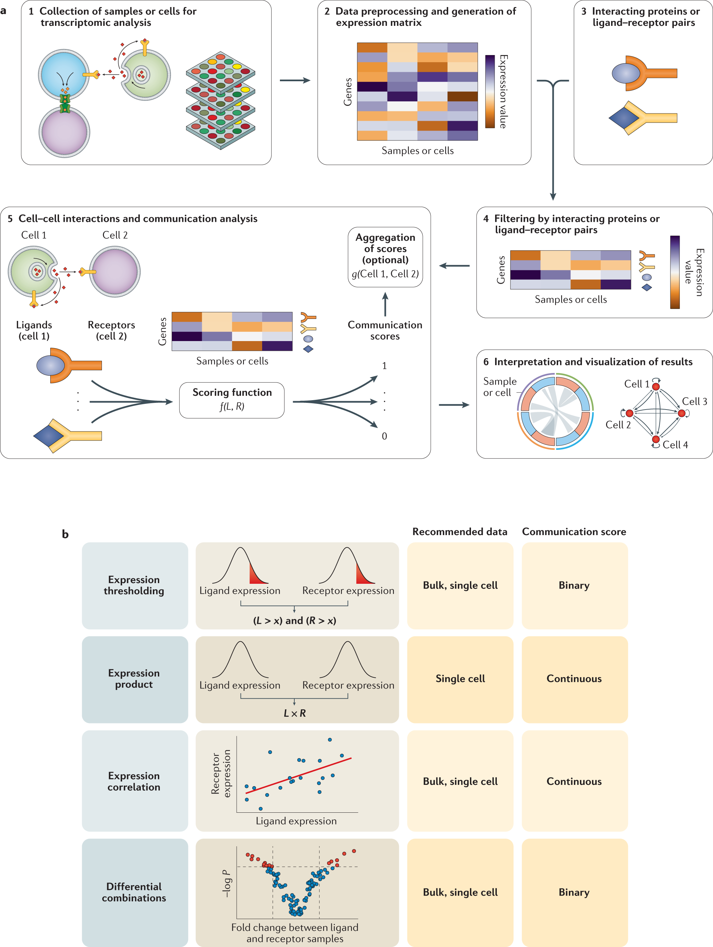
Introduction
Analysis & Results
Future work
Conclusion
Why & how study cell2cell Communications (CCC)?
Armingol et al. Nat Rev Genet. (2021)
Notes:
https://www.nature.com/articles/s41576-020-00292-x

Slide 7
Introduction
Analysis & Results
Future work
Conclusion
Why & how study cell2cell Communications (CCC)?
Armingol et al. Nat Rev Genet. (2021)
Notes:
https://www.nature.com/articles/s41576-020-00292-x

Slide 8
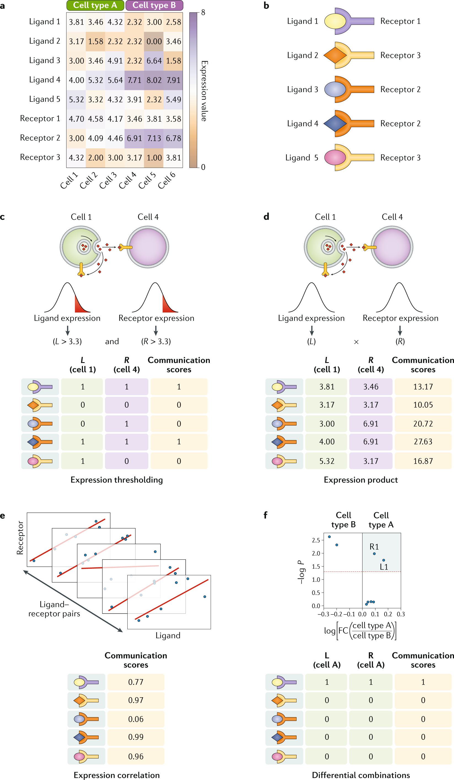
Introduction
Analysis & Results
Future work
Conclusion
Why & how study cell2cell Communications (CCC)?
Armingol et al. Nat Rev Genet. (2021)
Notes:
https://www.nature.com/articles/s41576-020-00292-x

Slide 9
Introduction
Analysis & Results
Future work
Conclusion
What are the possible interactions?
Cell 1
Cell 2
Notes:
https://www.nature.com/articles/s41576-020-00292-x

Slide 10
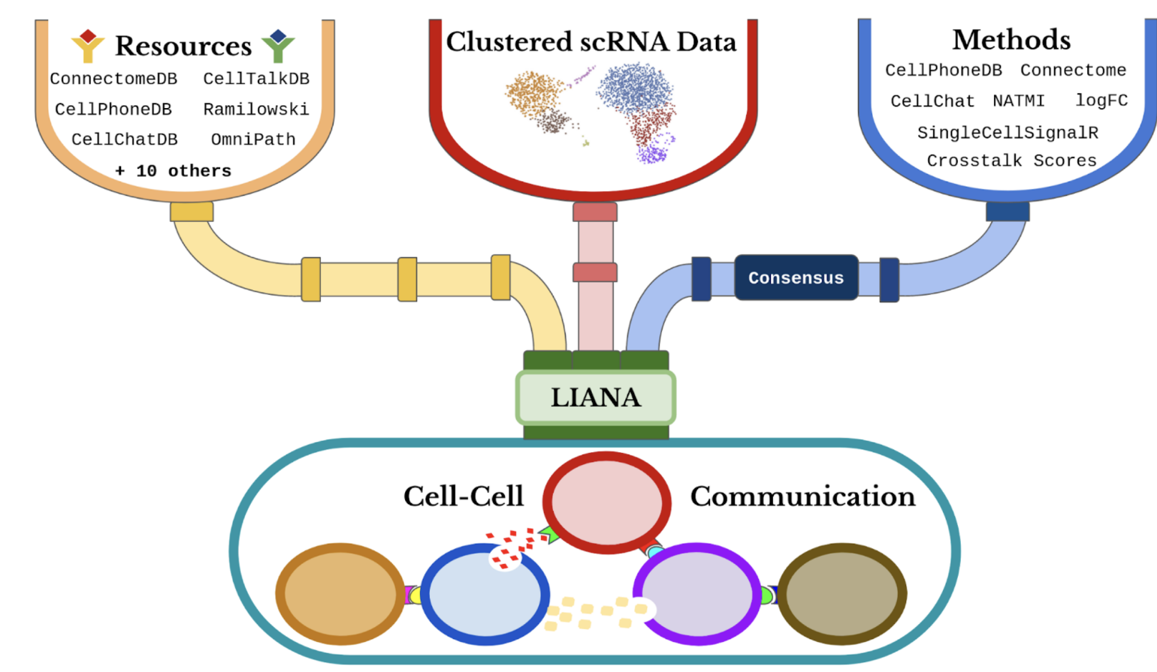
Introduction
Analysis & Results
Future work
Conclusion
What are the possible interactions?
Cell 1
Cell 2
Can be answered by many existing methods …
Notes:
https://www.nature.com/articles/s41576-020-00292-x

Slide 11
Introduction
Analysis & Results
Future work
Conclusion
What are the possible interactions?
Cell 1
Cell 2
Can be answered by many existing methods …
XX-YY
ZY-XX
ZZ-YX
YY-XZ
...
ZY-XX
YY-XZ
XX-YY
ZZ-YX
...
ZY-XX
XX-YY
ZZ-YX
YY-XZ
...
YY-XZ
XX-YY
ZY-XX
ZZ-YX
...
Individual ranked lists
Notes:
https://www.nature.com/articles/s41576-020-00292-x

Slide 12
Introduction
Analysis & Results
Future work
Conclusion
What are the possible interactions?
Cell 1
Cell 2
Standardized method?
Can be answered by many existing methods …
XX-YY
ZY-XX
ZZ-YX
YY-XZ
...
ZY-XX
YY-XZ
XX-YY
ZZ-YX
...
ZY-XX
XX-YY
ZZ-YX
YY-XZ
...
YY-XZ
XX-YY
ZY-XX
ZZ-YX
...
Individual ranked lists
Notes:
https://www.nature.com/articles/s41576-020-00292-x

Slide 13
Introduction
Analysis & Results
Future work
Conclusion
What are the possible interactions?
Cell 1
Cell 2
Standardized method?
Can be answered by many existing methods …
Prior knowledge
'Quality-coverage trade-off'
XX-YY
ZY-XX
ZZ-YX
YY-XZ
...
ZY-XX
YY-XZ
XX-YY
ZZ-YX
...
ZY-XX
XX-YY
ZZ-YX
YY-XZ
...
YY-XZ
XX-YY
ZY-XX
ZZ-YX
...
Individual ranked lists
Notes:
https://www.nature.com/articles/s41576-020-00292-x

Slide 14
Introduction
Analysis & Results
Future work
Conclusion
What are the possible interactions?
Cell 1
Cell 2
Benchmarking of different methods
Standardized method?
Can be answered by many existing methods …
Prior knowledge
'Quality-coverage trade-off'
XX-YY
ZY-XX
ZZ-YX
YY-XZ
...
ZY-XX
YY-XZ
XX-YY
ZZ-YX
...
ZY-XX
XX-YY
ZZ-YX
YY-XZ
...
YY-XZ
XX-YY
ZY-XX
ZZ-YX
...
Individual ranked lists
Notes:
https://www.nature.com/articles/s41576-020-00292-x

Slide 15
Introduction
Analysis & Results
Future work
Conclusion
What are the possible interactions?
Cell 1
Cell 2
Benchmarking of different methods
Standardized method?
Can be answered by many existing methods …
Single Ranking
Prior knowledge
'Quality-coverage trade-off'
XX-YY
ZY-XX
ZZ-YX
YY-XZ
...
ZY-XX
YY-XZ
XX-YY
ZZ-YX
...
ZY-XX
XX-YY
ZZ-YX
YY-XZ
...
YY-XZ
XX-YY
ZY-XX
ZZ-YX
...
Individual ranked lists
Notes:
https://www.nature.com/articles/s41576-020-00292-x

Slide 16

Introduction
Analysis & Results
Future work
Conclusion
What are the possible interactions?
Cell 1
Cell 2
Can be answered by many existing methods …
Single Ranking
XX-YY
ZY-XX
ZZ-YX
YY-XZ
...
YY-XZ
XX-YY
ZY-XX
ZZ-YX
...
XX-YY
YY-XZ
ZY-XX
…
ZZ-YX
ZY-XX
YY-XZ
XX-YY
ZZ-YX
...
ZY-XX
XX-YY
ZZ-YX
YY-XZ
...
Individual ranked lists
Notes:
https://www.nature.com/articles/s41576-020-00292-x

Slide 17

Introduction
Analysis & Results
Future work
Conclusion
What are the possible interactions?
Cell 1
Cell 2
Can be answered by many existing methods …
Robust Rank Aggregate (RRA) method from RobustRankAggreg package
Probabilistic Model
Single Ranking
ZZ-YX
XX-YY
ZY-XX
ZZ-YX
YY-XZ
...
YY-XZ
XX-YY
ZY-XX
ZZ-YX
...
XX-YY​
XX-YY
YY-XZ
ZY-XX
…
ZZ-YX
ZY-XX
YY-XZ
XX-YY
ZZ-YX
...
ZY-XX
XX-YY
ZZ-YX
YY-XZ
...
ZY-XX
YY-XZ
...
Universe
of all interaction predictions
Individual ranked lists
Notes:
https://www.nature.com/articles/s41576-020-00292-x

Slide 18
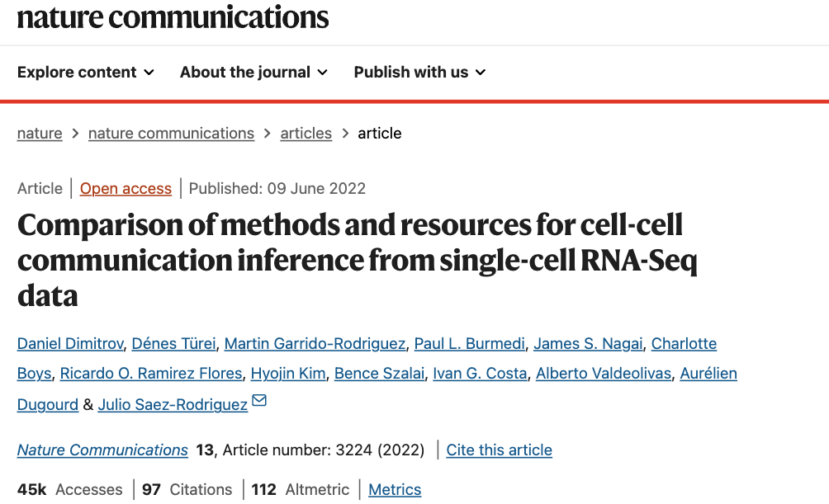
Introduction
Analysis & Results
Future work
Conclusion
Why & how study cell2cell Communications (CCC)?
Notes:
https://www.nature.com/articles/s41576-020-00292-x

Slide 19
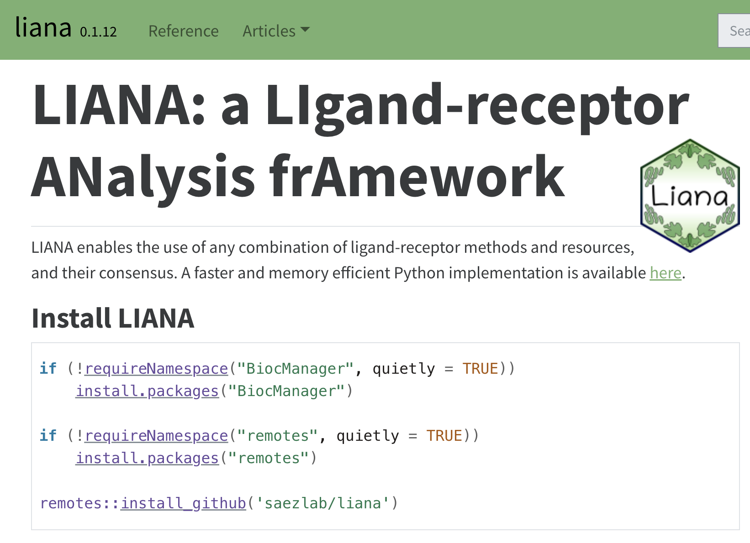
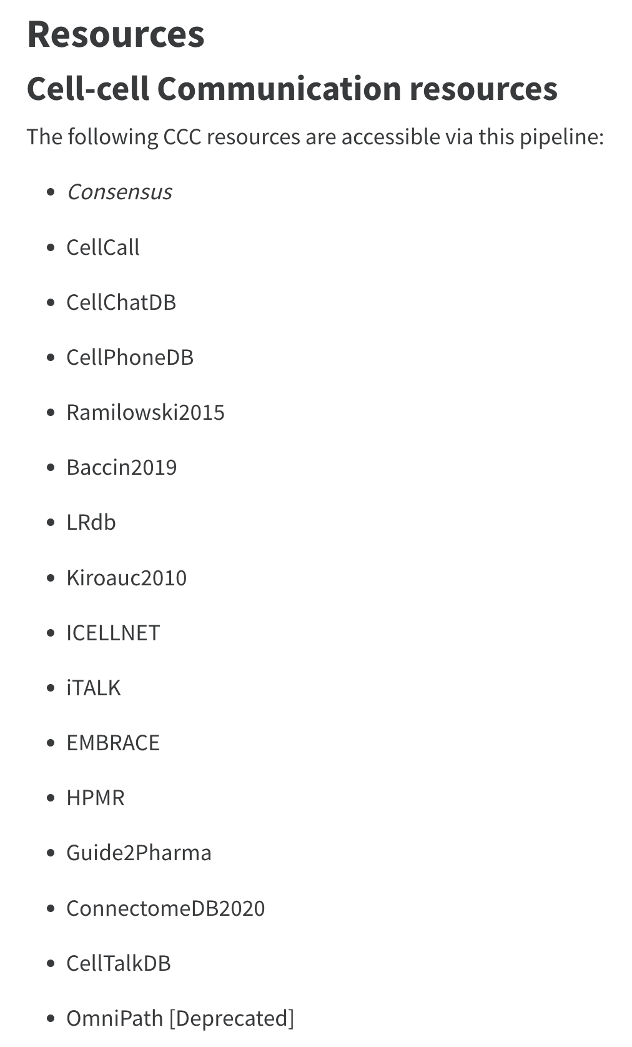
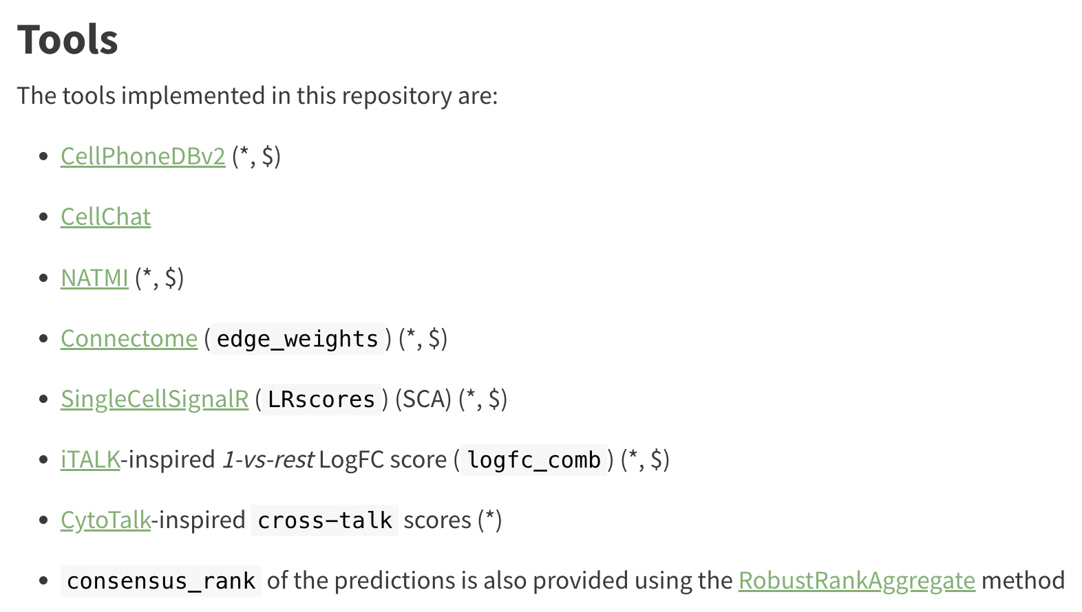
Introduction
Analysis & Results
Future work
Conclusion
Why & how study cell2cell Communications (CCC)?
Notes:
https://www.nature.com/articles/s41576-020-00292-x

Slide 20
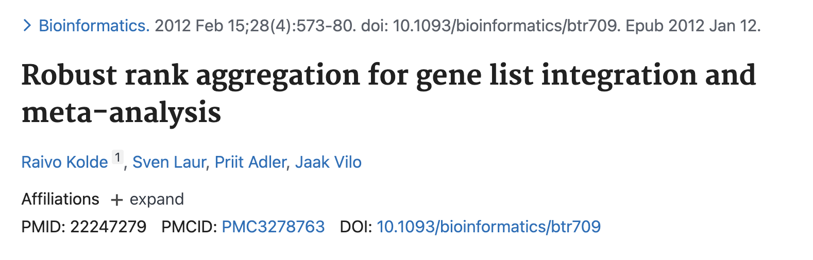
Introduction
Analysis & Results
Future work
Conclusion
Why & how study cell2cell Communications (CCC)?
Notes:
https://www.nature.com/articles/s41576-020-00292-x

Slide 21

Introduction
Analysis & Results
Future work
Conclusion
Why & how study cell2cell Communications (CCC)?
https://saezlab.github.io/liana/
Notes:
https://www.nature.com/articles/s41576-020-00292-x

Slide 22
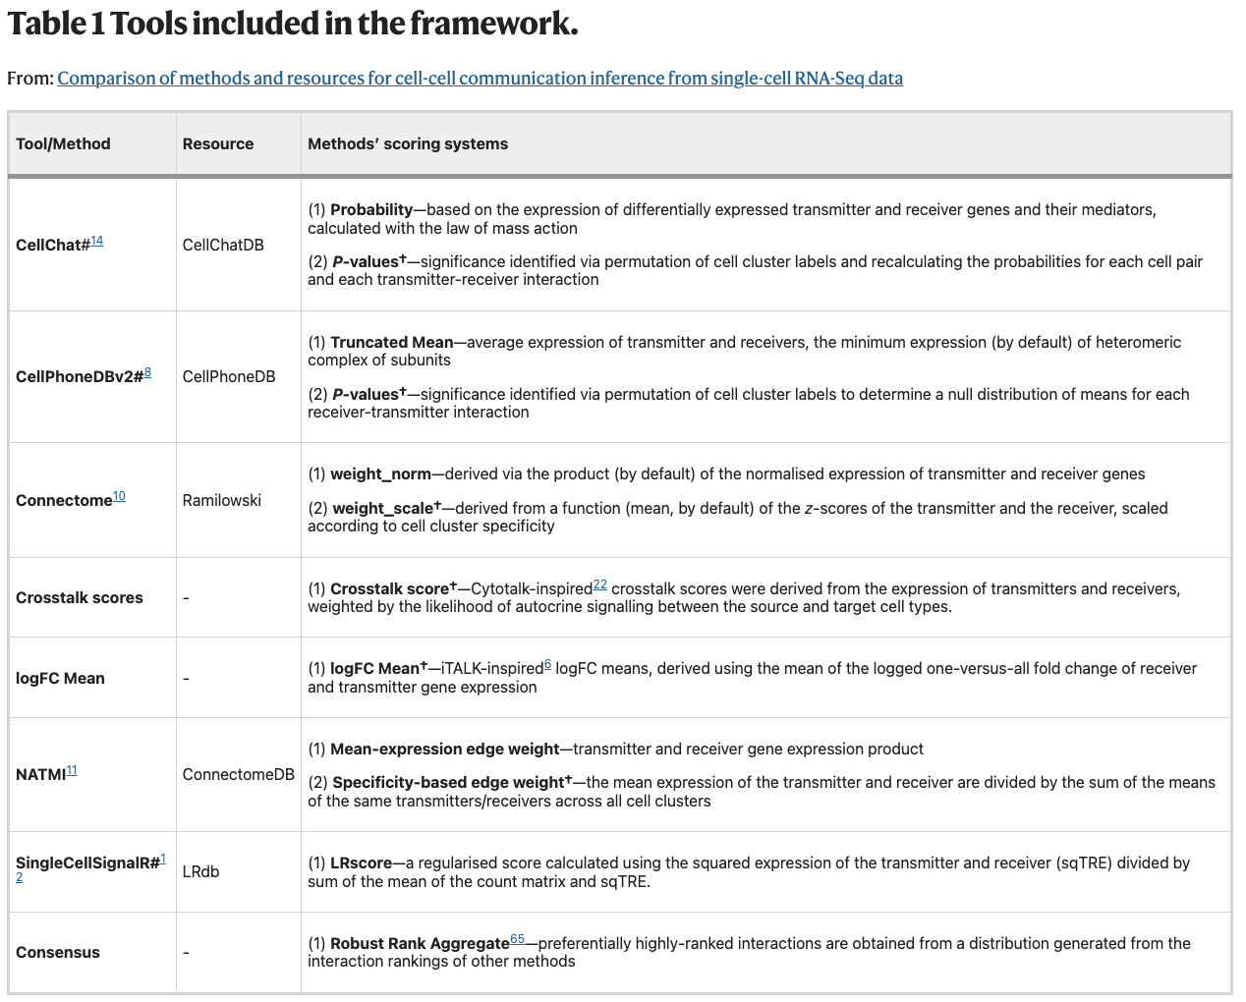
Introduction
Analysis & Results
Future work
Conclusion
Notes:
https://www.nature.com/articles/s41576-020-00292-x

Slide 23
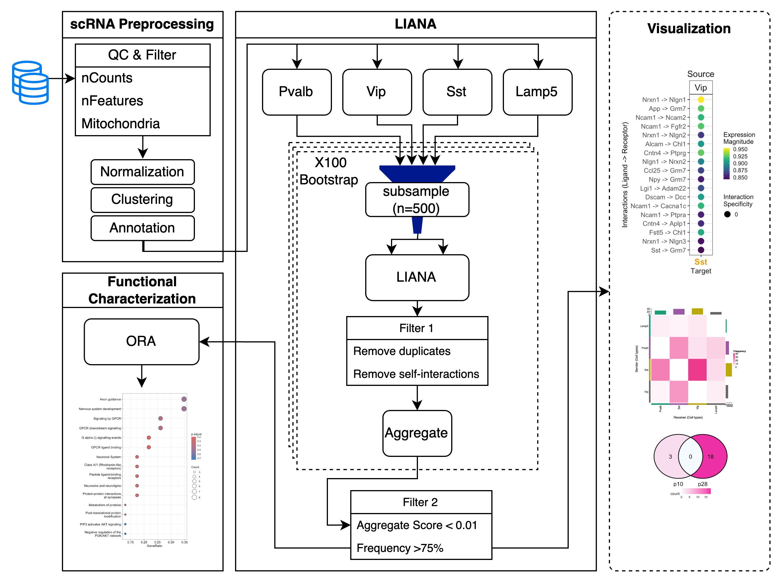
Introduction
Analysis & Results
Future work
Conclusion
Pipeline workflow

Slide 24
Introduction
Analysis & Results
Future work
Conclusion
Single-cell RNA-seq
LIANA
Functional Characterization
Notes:
Add the number of cells on top of each bar ?

Slide 25
Introduction
Analysis & Results
Future work
Conclusion
Single-cell RNA-seq
LIANA
Functional Characterization
1
Loading data:
p10: GSM5014306
p28: GSM5014308
2
Creating Seurat objects
for (sample in dirs){
cts <- ReadMtx(mtx = paste0(path, sample, "/", sample, "_V1_Dlxpos_RNA_matrix.mtx"),
features = paste0(path, sample, "/", sample, "_V1_Dlxpos_RNA_features.tsv"),
cells = paste0(path, sample, "/", sample, "_V1_Dlxpos_RNA_barcodes.tsv"))
assign(sample, CreateSeuratObject(counts = cts)) }
P10
P28
3
Merging data (p10 & p28)
merged_seurat <- merge(x = GSM5014306_P10, y = c(GSM5014308_P28), add.cell.id = c("GSM5014306_P10" ,"GSM5014308_P28"))
4
Adding QC matrices metadata
merged_seurat$log10GenesPerUMI_RNA <- log10(merged_seurat$nFeature_RNA) / log10(merged_seurat$nCount_RNA)
merged_seurat$mitoRatio <- PercentageFeatureSet(merged_seurat, pattern = "^mt-")
merged_seurat$mitoRatio <- merged_seurat@meta.data$mitoRatio / 100
Notes:
Add the number of cells on top of each bar ?

Slide 26
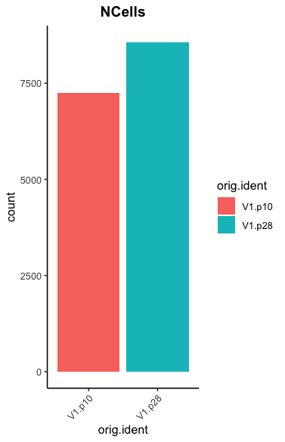
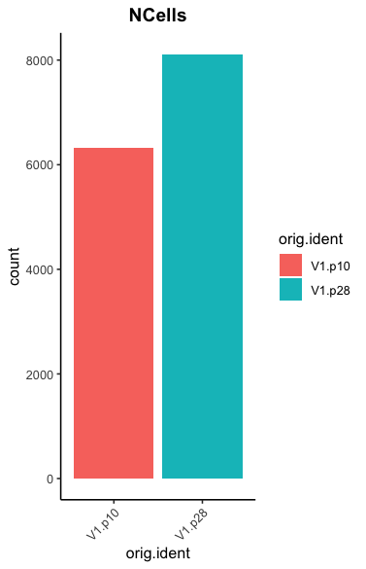
Introduction
Analysis & Results
Future work
Conclusion
Single-cell RNA-seq
LIANA
Functional Characterization
5
Filtering based on QC
nCount_min_filt <- 2000
nCount_max_filt <- 70000
nFeature_min_filt <- 1000
nFeature_max_filt <- 8000
mitoRatio_filt <- 0.1
filtered_seurat <- subset(merged_seurat, nCount_RNA >= nCount_min_filt& nCount_RNA <= nCount_max_filt & nFeature_RNA >= nFeature_min_filt & nFeature_RNA <= nFeature_max_filt & mitoRatio < mitoRatio_filt)
P10
P28
QC filtering
Notes:
Add the number of cells on top of each bar ?

Slide 27
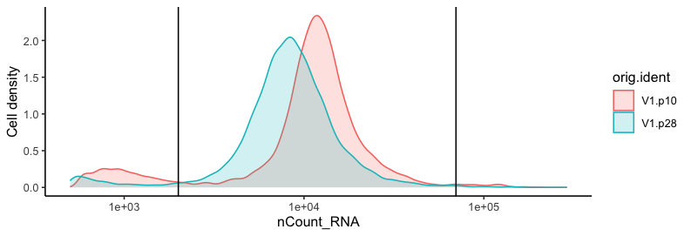
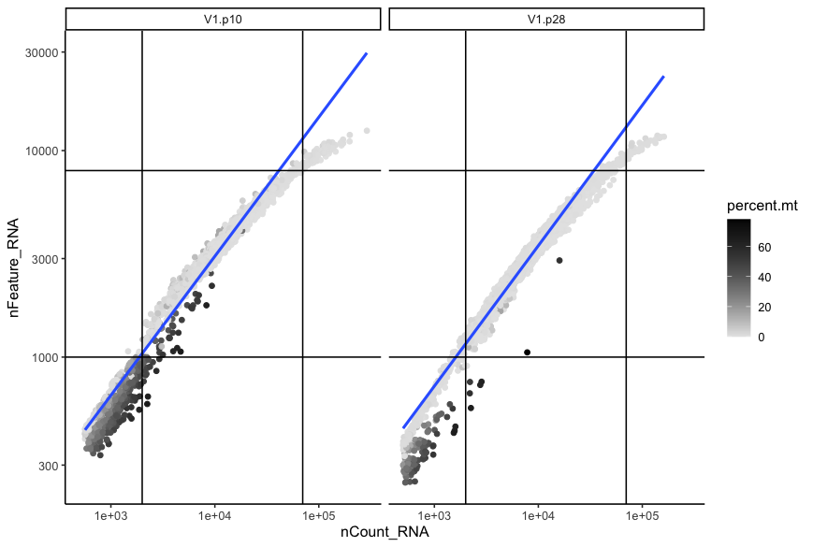
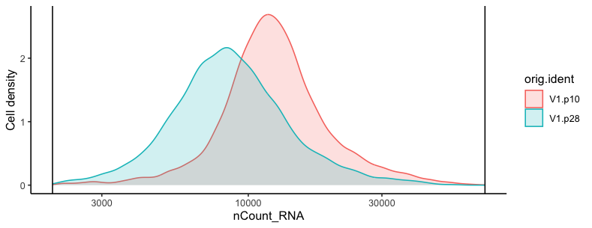
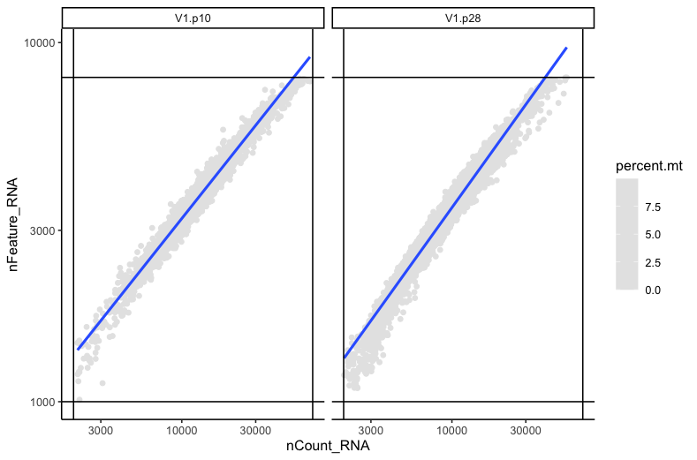
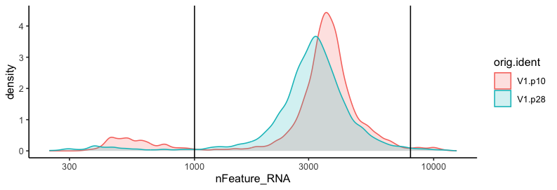
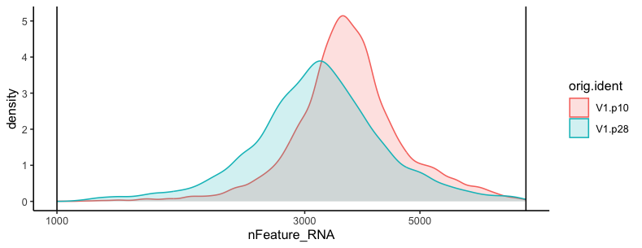
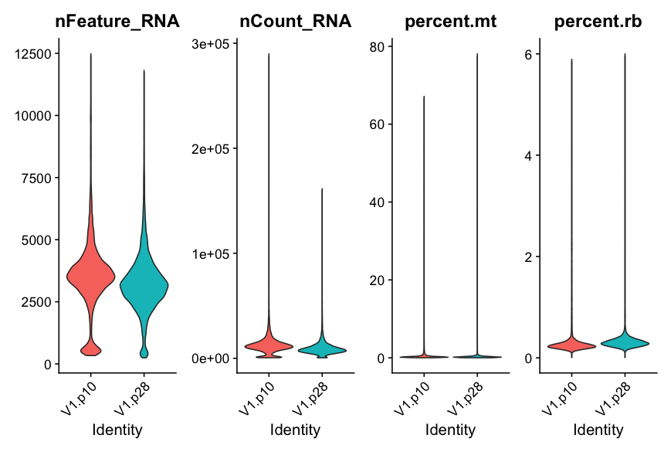
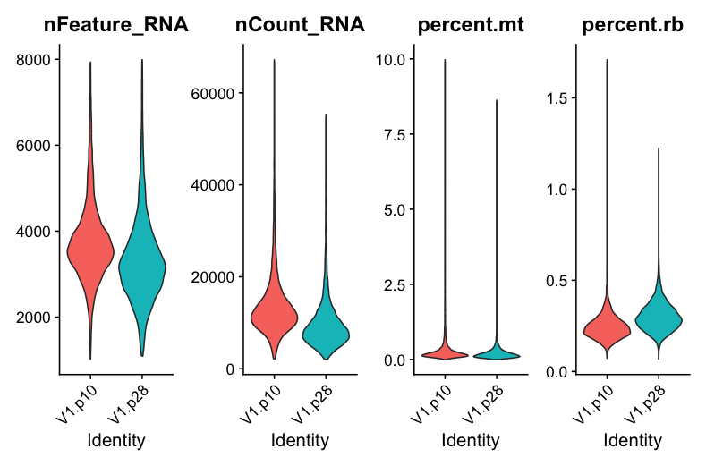
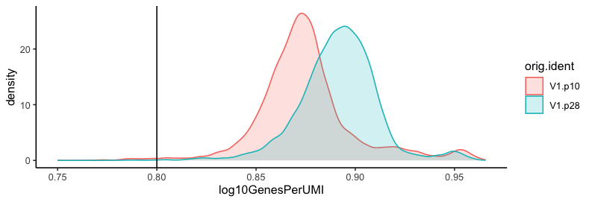
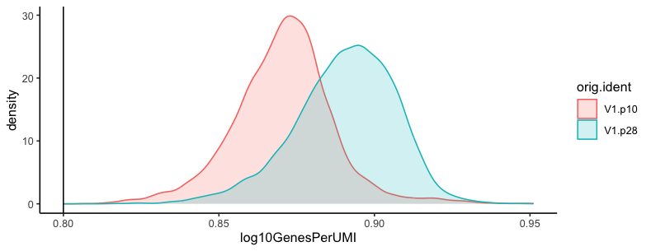
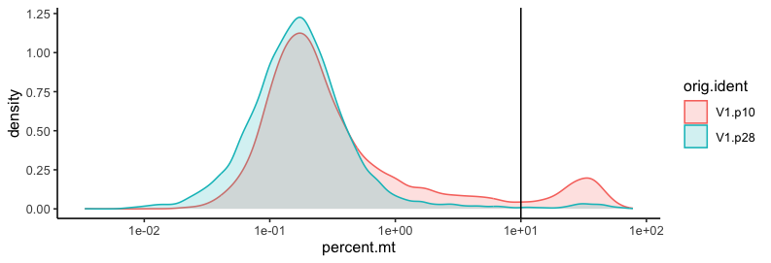
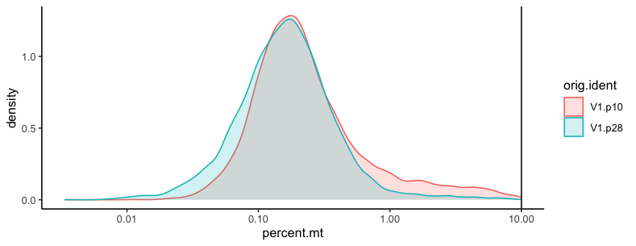
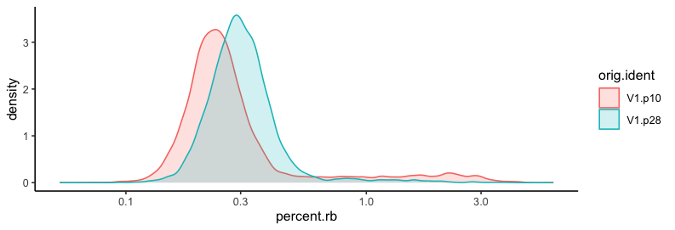
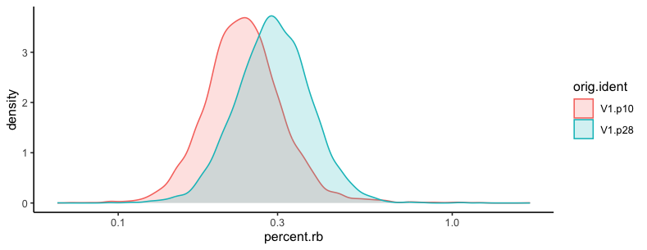
Introduction
Analysis & Results
Future work
Conclusion
Single-cell RNA-seq
LIANA
Functional Characterization
5
Filtering based on QC

Slide 28
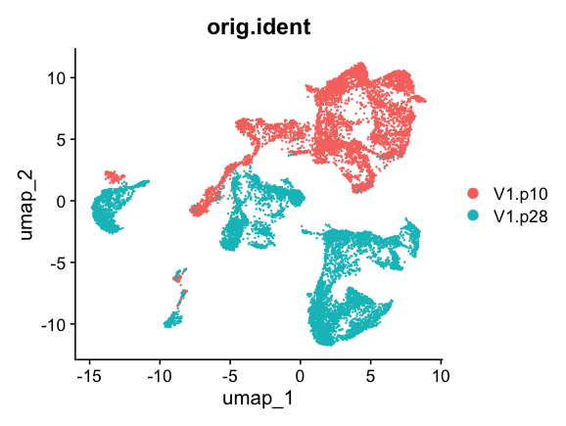
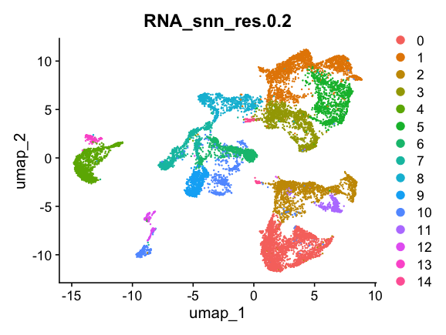
Introduction
Analysis & Results
Future work
Conclusion
Single-cell RNA-seq
LIANA
Functional Characterization
6
Normalize, VairableFeatures, Scale data, PCA, Clustering, visualize ...
seurat_obj <- NormalizeData(seurat_obj)
seurat_obj <- FindVariableFeatures(seurat_obj, selection.method = "vst", nfeatures = 2000, verbose = FALSE)
seurat_obj <- ScaleData(seurat_obj)
seurat_obj <- RunPCA(seurat_obj)
seurat_obj <- FindNeighbors(seurat_obj, dims = 1:30, reduction='pca')
seurat_obj <- FindClusters(seurat_obj, resolution = c(0.2,0.4, 0.6, 0.8, 1.0, 1.2))
seurat_obj <- RunUMAP( seurat_obj, dims=1:30, min.dist=0.3, reduction='pca', reduction.name = 'umap')

Slide 29
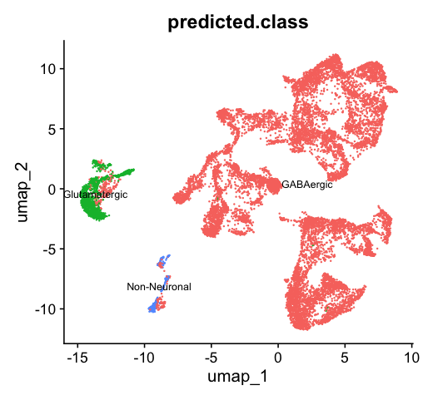
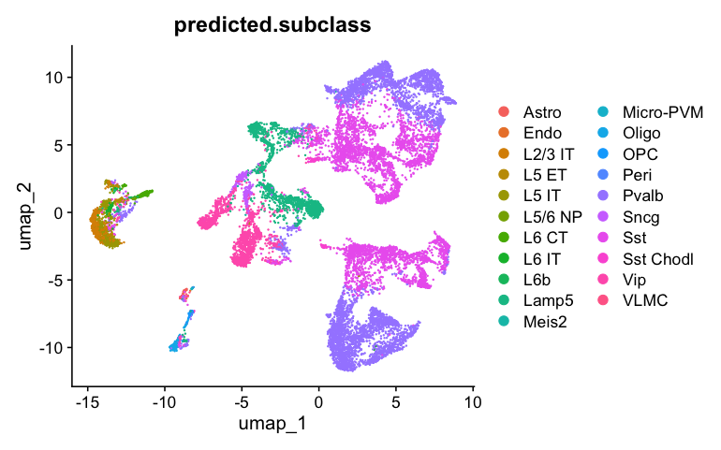
Introduction
Analysis & Results
Future work
Conclusion
Single-cell RNA-seq
LIANA
Functional Characterization
7
Cells Annotation
seurat_obj <- Azimuth::RunAzimuth(seurat_obj, reference = "mousecortexref")
P10
P28
Lamp5
GABAergic
(inhibitory)
Pvalb
Vip
SST
Diverse interneurons
Glutamatergic
(excitatory)
Non-Neuronal

Slide 30
Introduction
Analysis & Results
Future work
Conclusion
Single-cell RNA-seq
LIANA
Functional Characterization
Notes:
Add the number of cells on top of each bar ?

Slide 31
Introduction
Analysis & Results
Future work
Conclusion
Single-cell RNA-seq
LIANA
Functional Characterization
We have expression data
for our cells of interest
Sst
1
Pvalb
Lamp5
Vip
Bias: unequal cell number in each subtype
Thus, subsampling
2221
515
2501
647
Pvalb
Vip
Sst
Lamp5
500
500
500
500

Slide 32
Introduction
Analysis & Results
Future work
Conclusion
Single-cell RNA-seq
LIANA
Functional Characterization
We have expression data
for our cells of interest
Sst
Pvalb
Lamp5
source | target | ligand | receptor | prob | pval
Lamp5 | Lamp5 | L1cam | Egfr | 0.0134 | 0
Pvalb | Lamp5 | L1cam | Egfr | 0.0124 | 0
Sst | Lamp5 | L1cam | Egfr | 0.0283 | 0
Vip | Lamp5 | L1cam | Egfr | 0.0164 | 0
Vip
2221
515
2501
647
Pvalb
Vip
Sst
Lamp5
500
500
500
500
Search in known
L-R databases and get predictions for 3 methods used
source | target | ligand | receptor | receptor.prop | ligand.prop | ligand.expr | receptor.expr | lrs.to.keep | lr.mean | pvalue
Lamp5 | Lamp5 | Adam10 | Tspan12 | 0.188 | 0.722 | 0.681 | 0.0827 | TRUE | 0.382 | 0
Lamp5 | Lamp5 | Adam10 | Met | 0.174 | 0.722 | 0.681 | 0.0492 | TRUE | 0.365 | 0
Lamp5 | Lamp5 | Adam10 | Epha3 | 0.978 | 0.722 | 0.681 | 1.29 | TRUE | 0.985 | 0.716
Lamp5 | Lamp5 | Adam10 | Nrcam | 0.922 | 0.722 | 0.681 | 0.0632 | TRUE | 0.372 | 0
LIANA
Cell_chat
Cellphone
Sca
source | target | ligand | receptor | receptor.prop | ligand.prop | ligand.expr | receptor.expr | global_mean | lrs.to.keep | LRscore
Lamp5 | Lamp5 | Adam10 | Tspan12 | 0.188 | 0.722 | 0.681 | 0.0827 | 0.145 | TRUE | 0.621
Lamp5 | Lamp5 | Adam10 | Met | 0.174 | 0.722 | 0.681 | 0.0492 | 0.145 | TRUE | 0.558
Lamp5 | Lamp5 | Adam10 | Epha3 | 0.978 | 0.722 | 0.681 | 1.29 | 0.145 | TRUE | 0.866
Lamp5 | Lamp5 | Adam10 | Nrcam | 0.922 | 0.722 | 0.681 | 0.0632 | 0.145 | TRUE | 0.589

Slide 33
Introduction
Analysis & Results
Future work
Conclusion
Single-cell RNA-seq
LIANA
Functional Characterization
We have expression data
for our cells of interest
Sst
Pvalb
Lamp5
source | target | ligand | receptor | prob | pval
Lamp5 | Lamp5 | L1cam | Egfr | 0.0134 | 0
Pvalb | Lamp5 | L1cam | Egfr | 0.0124 | 0
Sst | Lamp5 | L1cam | Egfr | 0.0283 | 0
Vip | Lamp5 | L1cam | Egfr | 0.0164 | 0
Vip
2221
515
2501
647
Pvalb
Vip
Sst
Lamp5
500
500
500
500
Search in known
L-R databases and get predictions for 3 methods used
source | target | ligand | receptor | receptor.prop | ligand.prop | ligand.expr | receptor.expr | lrs.to.keep | lr.mean | pvalue
Lamp5 | Lamp5 | Adam10 | Tspan12 | 0.188 | 0.722 | 0.681 | 0.0827 | TRUE | 0.382 | 0
Lamp5 | Lamp5 | Adam10 | Met | 0.174 | 0.722 | 0.681 | 0.0492 | TRUE | 0.365 | 0
Lamp5 | Lamp5 | Adam10 | Epha3 | 0.978 | 0.722 | 0.681 | 1.29 | TRUE | 0.985 | 0.716
Lamp5 | Lamp5 | Adam10 | Nrcam | 0.922 | 0.722 | 0.681 | 0.0632 | TRUE | 0.372 | 0
LIANA
Cell_chat
Cellphone
Sca
source | target | ligand | receptor | receptor.prop | ligand.prop | ligand.expr | receptor.expr | global_mean | lrs.to.keep | LRscore
Lamp5 | Lamp5 | Adam10 | Tspan12 | 0.188 | 0.722 | 0.681 | 0.0827 | 0.145 | TRUE | 0.621
Lamp5 | Lamp5 | Adam10 | Met | 0.174 | 0.722 | 0.681 | 0.0492 | 0.145 | TRUE | 0.558
Lamp5 | Lamp5 | Adam10 | Epha3 | 0.978 | 0.722 | 0.681 | 1.29 | 0.145 | TRUE | 0.866
Lamp5 | Lamp5 | Adam10 | Nrcam | 0.922 | 0.722 | 0.681 | 0.0632 | 0.145 | TRUE | 0.589

Slide 34
Introduction
Analysis & Results
Future work
Conclusion
Single-cell RNA-seq
LIANA
Functional Characterization
We have expression data
for our cells of interest
Sst
Pvalb
Lamp5
Vip
2221
515
2501
647
Pvalb
Vip
Sst
Lamp5
500
500
500
500
Search in known
L-R databases and get predictions for 3 methods used
Cell_chat
LIANA
Cellphone
source | target | ligand | receptor | aggregate_rank | mean_rank | call_cellchat.pval | call_cellchat.rank | cellphonedb.pvalue | cellphonedb.rank | sca.LRscore | sca.rank
Lamp5 | Sst | L1cam | Cntn1 | 0.0002 | 86.66667 | 0.43 | 17 | 0 | 122 | 0.853760711 | 121
Lamp5 | Sst | Jam3 | Itgb1 | 0.0038 | 153.8333 | 0 | 6.5 | 0 | 122 | 0.692454958 | 333
Lamp5 | Sst | Vegfc | Itgb1 | 0.0042 | 157.5 | 0 | 6.5 | 0 | 122 | 0.685291037 | 344
Lamp5 | Pvalb | L1cam | Cntn1 | 0.0019 | 139.8333 | 0.63 | 20 | 0.007 | 263.5 | 0.845365391 | 136
Lamp5 | Pvalb | Lamc1 | Itga9 | 0.0027 | 141.1667 | 0 | 9 | 0 | 117.5 | 0.718608224 | 297
Lamp5 | Pvalb | Vegfc | Itgb1 | 0.0034 | 149.1667 | 0 | 9 | 0 | 117.5 | 0.698217147 | 321
Lamp5 | Pvalb | Jam3 | Itgb1 | 0.0036 | 151.8333 | 0 | 9 | 0 | 117.5 | 0.692983726 | 329
Lamp5 | Pvalb | Vegfc | Itga9 | 0.0064 | 174.8333 | 0 | 9 | 0 | 117.5 | 0.645009063 | 398
Sca
Aggregate scores from the 3 methods
LIANA aggregate

Slide 35
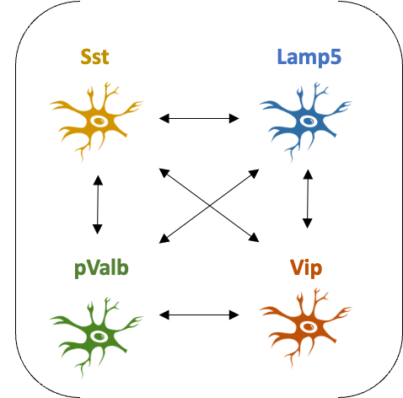
Introduction
Analysis & Results
Future work
Conclusion
Single-cell RNA-seq
LIANA
Functional Characterization
We have expression data
for our cells of interest
Sst
Pvalb
Lamp5
Vip
2221
515
2501
647
Pvalb
Vip
Sst
Lamp5
source | target | ligand | receptor | aggregate_rank | mean_rank | call_cellchat.pval | call_cellchat.rank | cellphonedb.pvalue | cellphonedb.rank | sca.LRscore | sca.rank
Lamp5 | Sst | L1cam | Cntn1 | 0.0002 | 86.66667 | 0.43 | 17 | 0 | 122 | 0.853760711 | 121
Lamp5 | Sst | Jam3 | Itgb1 | 0.0038 | 153.8333 | 0 | 6.5 | 0 | 122 | 0.692454958 | 333
Lamp5 | Sst | Vegfc | Itgb1 | 0.0042 | 157.5 | 0 | 6.5 | 0 | 122 | 0.685291037 | 344
Lamp5 | Pvalb | L1cam | Cntn1 | 0.0019 | 139.8333 | 0.63 | 20 | 0.007 | 263.5 | 0.845365391 | 136
Lamp5 | Pvalb | Lamc1 | Itga9 | 0.0027 | 141.1667 | 0 | 9 | 0 | 117.5 | 0.718608224 | 297
Lamp5 | Pvalb | Vegfc | Itgb1 | 0.0034 | 149.1667 | 0 | 9 | 0 | 117.5 | 0.698217147 | 321
Lamp5 | Pvalb | Jam3 | Itgb1 | 0.0036 | 151.8333 | 0 | 9 | 0 | 117.5 | 0.692983726 | 329
Lamp5 | Pvalb | Vegfc | Itga9 | 0.0064 | 174.8333 | 0 | 9 | 0 | 117.5 | 0.645009063 | 398
500
500
500
500
Search in known
L-R databases and get predictions for 3 methods used
Cell_chat
LIANA
Cellphone
Sca
Aggregate scores from the 3 methods
LIANA aggregate
Filter
Self interactions
Agg score < 0.01
2
Robust interactions?
Filter by agg score

Slide 36
Introduction
Analysis & Results
Future work
Conclusion
Single-cell RNA-seq
LIANA
Functional Characterization
We have expression data
for our cells of interest
Sst
Pvalb
Lamp5
Vip
2221
515
2501
647
Pvalb
Vip
Sst
Lamp5
500
500
500
500
Search in known
L-R databases and get predictions for 3 methods used
Cell_chat
LIANA
Cellphone
Sca
Aggregate scores from the 3 methods
LIANA aggregate
Filter
Self interactions
Agg score < 0.01

Slide 37
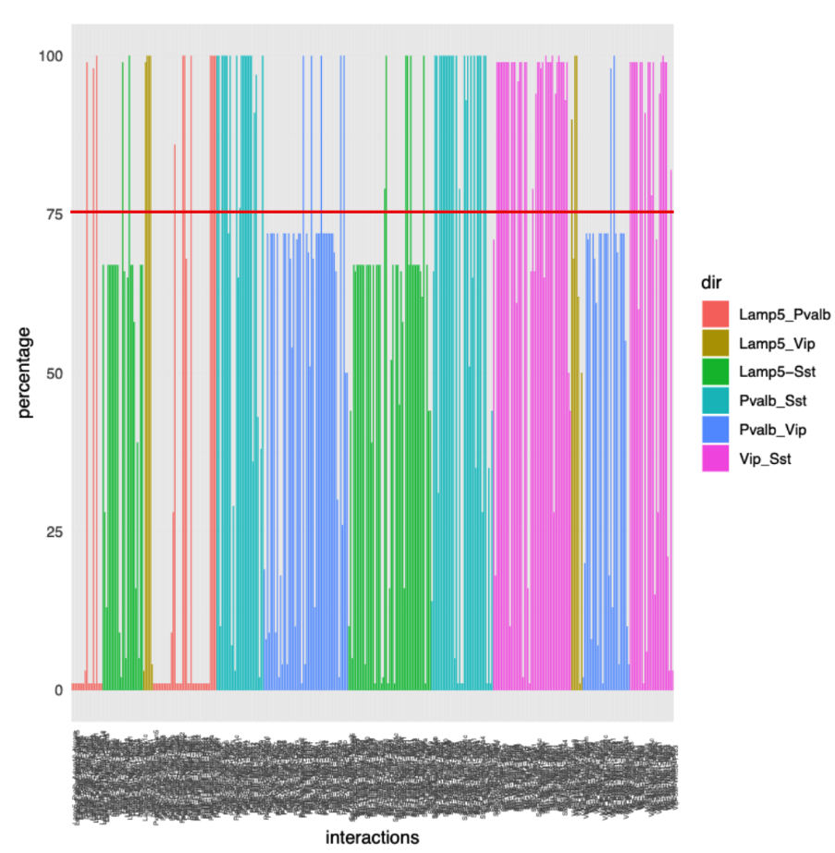
Introduction
Analysis & Results
Future work
Conclusion
Single-cell RNA-seq
LIANA
Functional Characterization
We have expression data
for our cells of interest
Sst
Pvalb
Lamp5
Vip
2221
515
2501
647
Pvalb
Vip
Sst
Lamp5
500
Pvalb
500
Vip
500
Sst
500
Lamp5
500
Pvalb
500
Vip
500
Sst
500
Lamp5
Search in known
L-R databases and get predictions for 3 methods used
500
Pvalb
500
Vip
500
Sst
500
Lamp5
LIANA
Cell_chat
500
500
500
500
Cell_chat
LIANA
Cellphone
Cellphone
Sca
Cell_chat
LIANA
Sca
Cell_chat
LIANA
Cellphone
Cellphone
Aggregate scores from the 3 methods
Sca
LIANA aggregate
Sca
LIANA aggregate
x 100
LIANA aggregate
LIANA aggregate
Filter
Self interactions
Agg score < 0.01
Filter
Self interactions
Agg score < 0.01
Keep only interactions that appeared 75/100 bootstraps
Filter
Self interactions
Agg score < 0.01
Filter
Self interactions
Agg score < 0.01
3
Robust interactions?
Filter by %

Slide 38
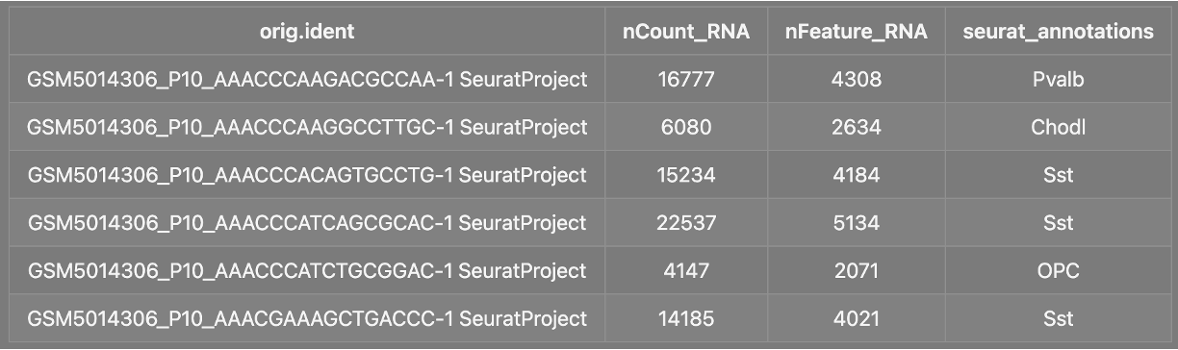
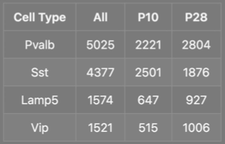
Introduction
Analysis & Results
Future work
Conclusion
Single-cell RNA-seq
LIANA
Functional Characterization
Running LIANA
Now, that we have processed counts & annotated cells... we can run LIANA to infer possible CCI
Possible interactions:
Lamp5_Sst
Lamp5_Pvalb
Lamp5_Vip
Pvalb_Sst
Pvalb_Vip
Vip_Sst
P10
P28
Not interested in interactions of a cell with itself

Slide 39
Introduction
Analysis & Results
Future work
Conclusion
Single-cell RNA-seq
LIANA
Functional Characterization
Running LIANA
Now, that we have processed counts & annotated cells... we can run LIANA to infer possible CCI
Possible interactions:
Lamp5_Sst
Lamp5_Pvalb
Lamp5_Vip
Pvalb_Sst
Pvalb_Vip
Vip_Sst
P10
P28
Not interested in interactions of a cell with itself
1
Bias: unequal cell number in each subtype
Thus, subsampling

Slide 40
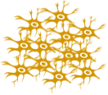



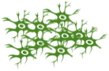
Introduction
Analysis & Results
Future work
Conclusion
Single-cell RNA-seq
LIANA
Functional Characterization
Bootstrapping approach:
e.g.
Sst
RSS
Predict interactions (LIANA)
Keep direct interactions
Aggregate results (from different methods; LIANA)
Store result
Vip
RSS
RSS = Random subsampling (~500 cells)
1
Bias: unequal cell number in each subtype
Thus, subsampling

Slide 41
Introduction
Analysis & Results
Future work
Conclusion
Single-cell RNA-seq
LIANA
Functional Characterization
Bootstrapping approach:
e.g.
Sst
RSS
Predict interactions (LIANA)
Keep direct interactions
Aggregate results (from different methods; LIANA)
Store result
Vip
RSS
RSS = Random subsampling (~500 cells)
Possible interactions:
Lamp5_Sst
Lamp5_Pvalb
Lamp5_Vip
Pvalb_Sst
Pvalb_Vip
Vip_Sst
P10
P28
2
Not interested in interactions of a cell with itself

Slide 42
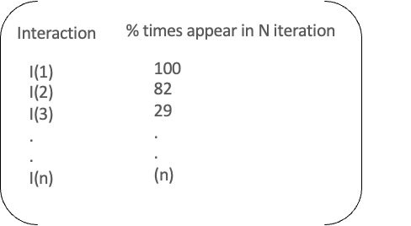
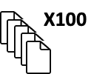
Introduction
Analysis & Results
Future work
Conclusion
Single-cell RNA-seq
LIANA
Functional Characterization
Bootstrapping approach:
e.g.
Sst
RSS
Predict interactions (LIANA)
Keep direct interactions
Aggregate results (from different methods; LIANA)
Store result
Vip
RSS
Interaction results
(N_bootstrap = 100)
RSS = Random subsampling (~500 cells)
3
Robust interactions?

Slide 43
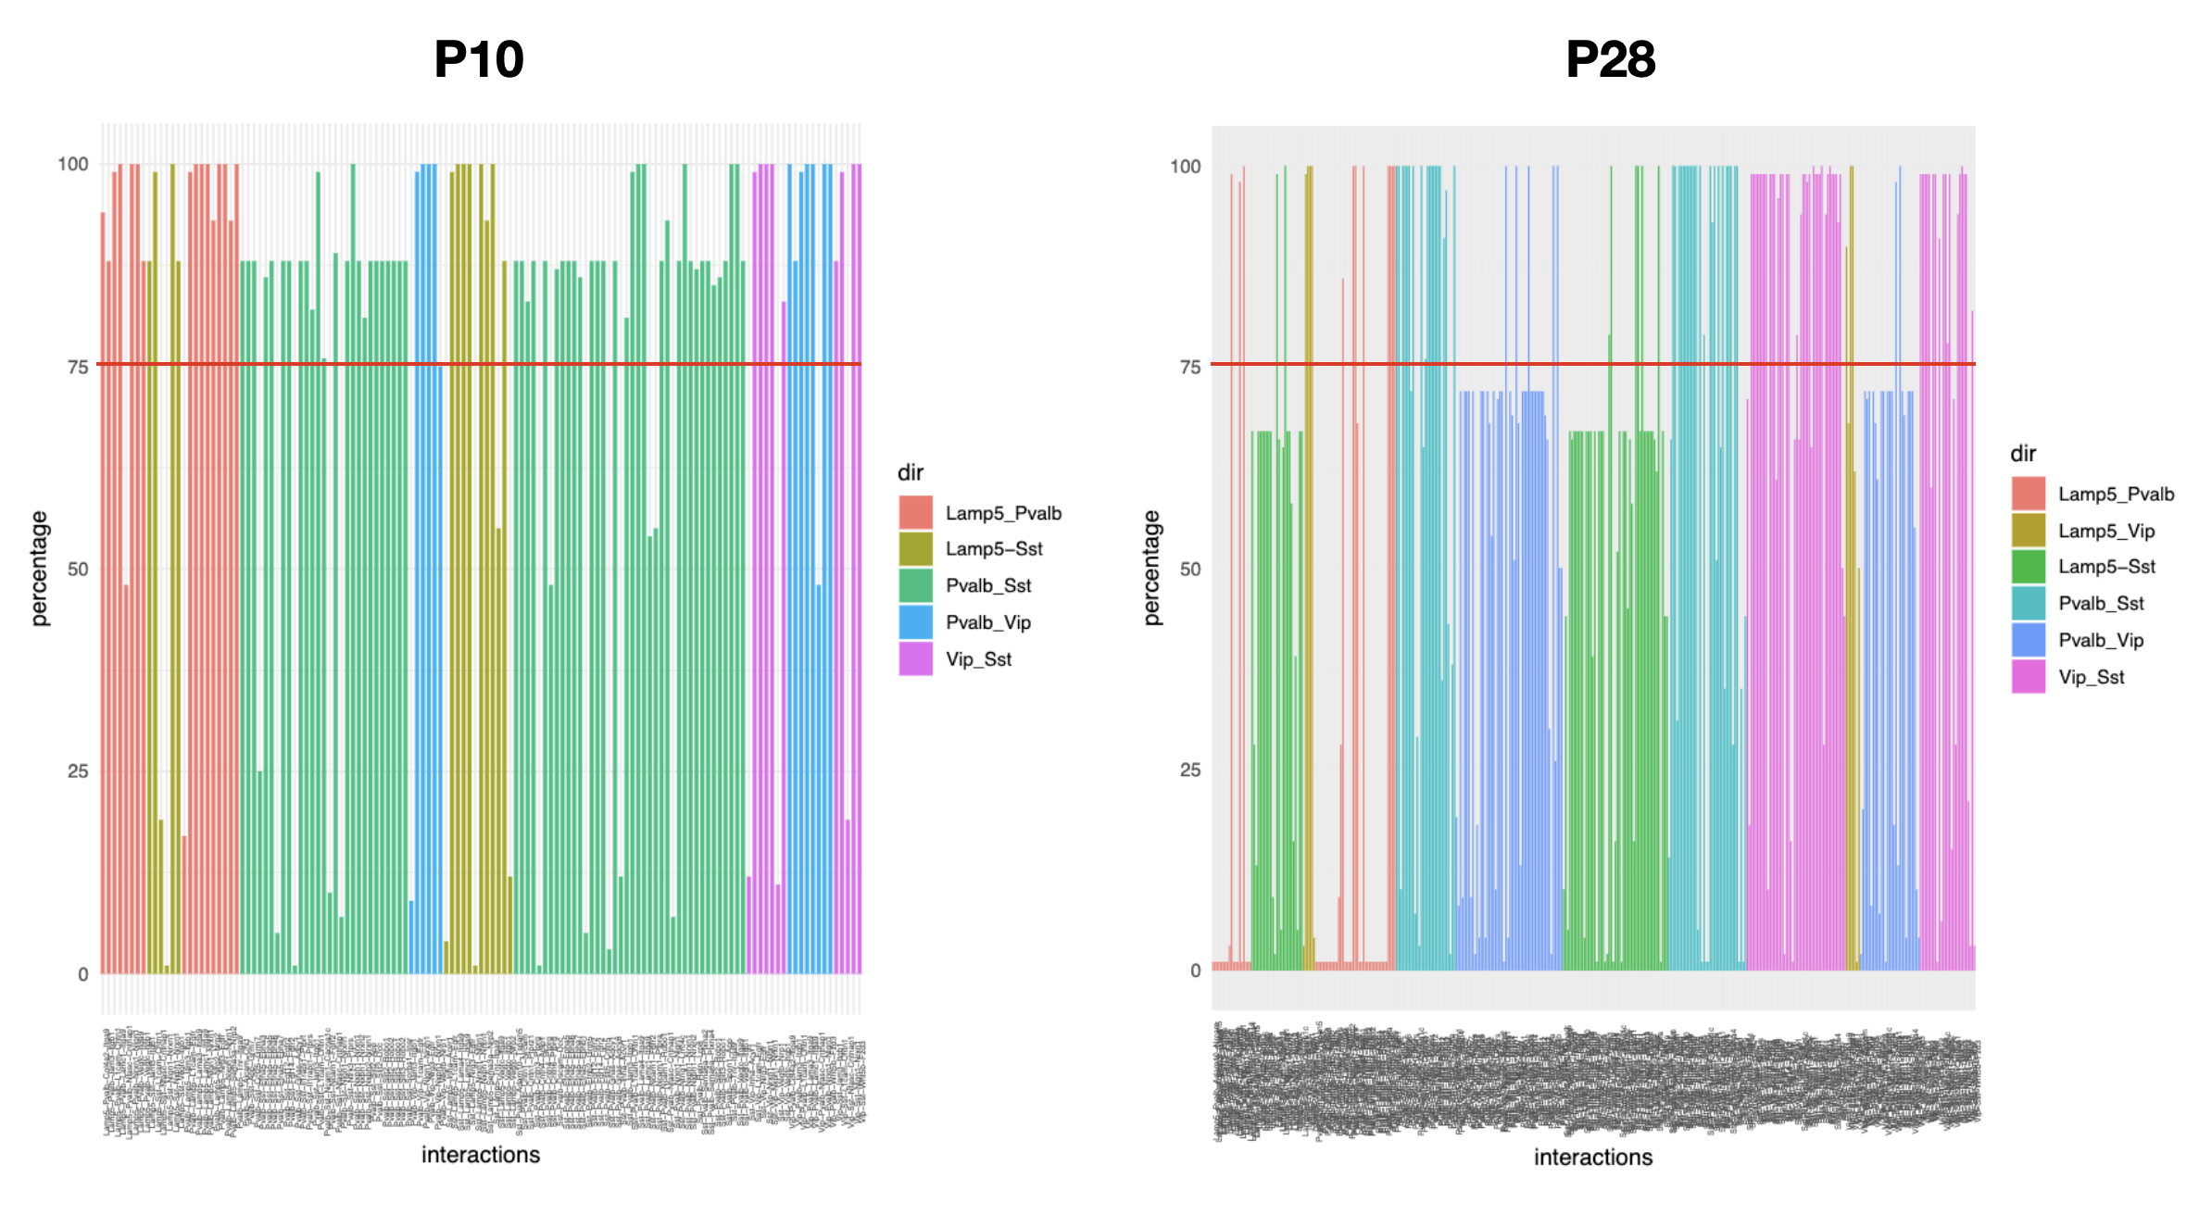
Introduction
Analysis & Results
Future work
Conclusion
Single-cell RNA-seq
LIANA
Functional Characterization
Bootstrapping approach:
e.g.
Sst
RSS
Predict interactions (LIANA)
Keep direct interactions
Aggregate results (from different methods; LIANA)
Store result
Vip
RSS
Interaction results
(N_bootstrap = 100)
RSS = Random subsampling (~500 cells)
3
Robust interactions?
Filter by %

Slide 44
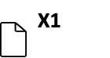
Introduction
Analysis & Results
Future work
Conclusion
Single-cell RNA-seq
LIANA
Functional Characterization
Bootstrapping approach:
e.g.
Sst
RSS
Predict interactions (LIANA)
Keep direct interactions
Aggregate results (from different methods; LIANA)
Store result
Vip
RSS
Interaction results
(N_bootstrap = 100)
RSS = Random subsampling (~500 cells)
3
Robust interactions?
Filter by %
Subset robust interactions & randomly choose a single LIANA output data-frame

Slide 45
Introduction
Analysis & Results
Future work
Conclusion
Single-cell RNA-seq
LIANA
Functional Characterization
Bootstrapping approach:
e.g.
Sst
RSS
Predict interactions (LIANA)
Keep direct interactions
Aggregate results (from different methods; LIANA)
Store result
Vip
RSS
RSS = Random subsampling (~500 cells)
3
Robust interactions?
Filter by %
Filter by aggregate_rank score

Slide 46
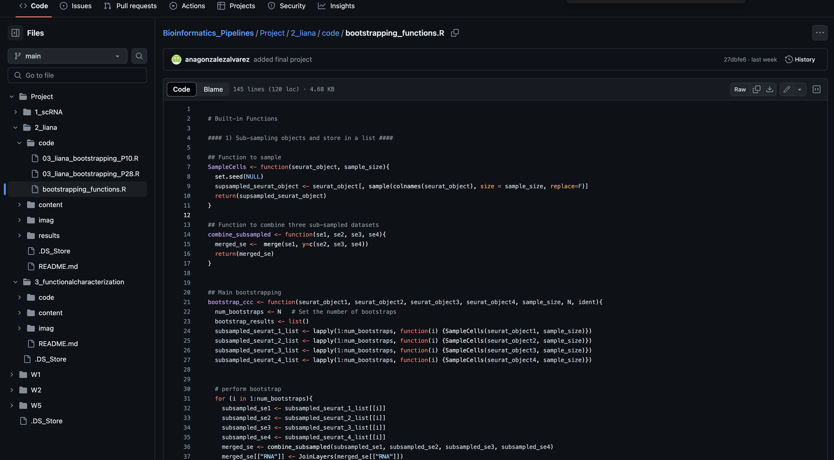
Introduction
Analysis & Results
Future work
Conclusion
Single-cell RNA-seq
LIANA
Functional Characterization
Bootstrapping approach:
Liana functions:
liana_wrap()
liana_aggregate()
In-house functions:
SampleCells()
bootstrap_keep_dir()
bootstrap_results_agg()
filter_aggRank()
keep_specific_inter()
...
Handling multiple tibbles from the bootstrapping
Available at: https://github.com/anagonzalezalvarez/Bioinformatics_Pipelines/blob/main/Project/2_liana/code/bootstrapping_functions.R

Slide 47
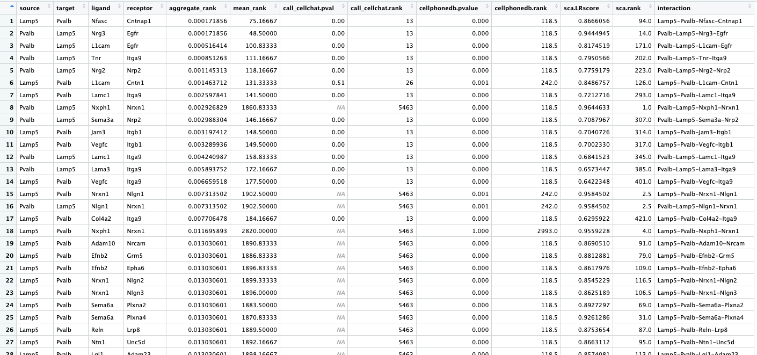
Introduction
Analysis & Results
Future work
Conclusion
Single-cell RNA-seq
LIANA
Functional Characterization
LIANA output

Slide 48
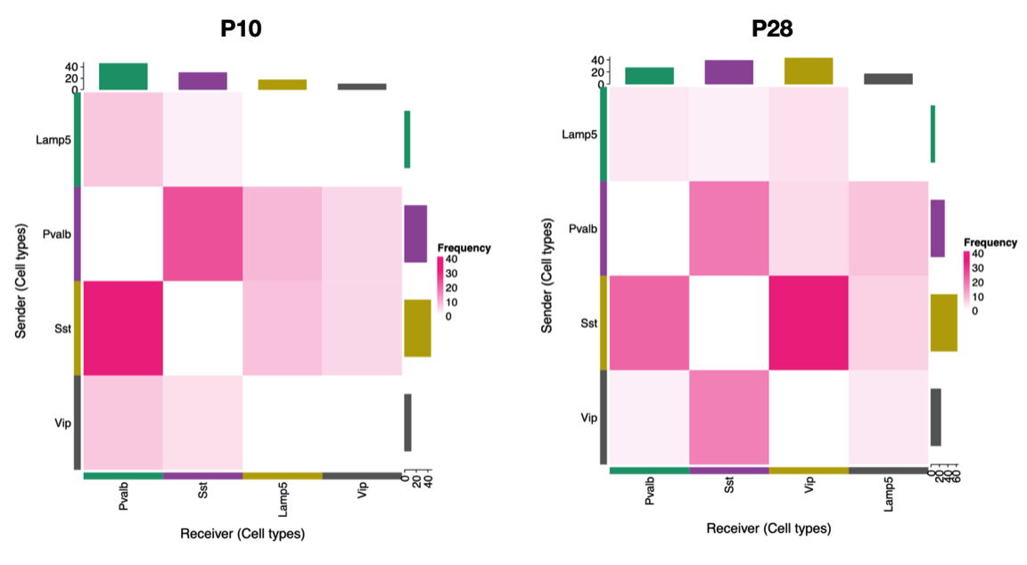
Introduction
Analysis & Results
Future work
Conclusion
Single-cell RNA-seq
LIANA
Functional Characterization
Sst ←→ Vip
Sst ←→ Pvalb
Stronger interactions observed between those subtypes: Sst with either Vip or Pvalb

Slide 49
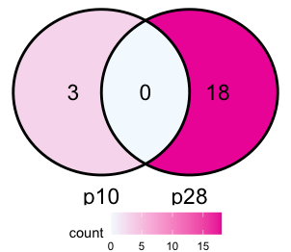
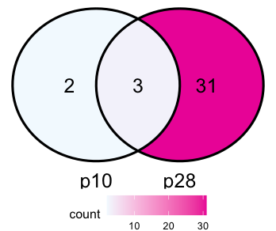
Introduction
Analysis & Results
Future work
Conclusion
Single-cell RNA-seq
LIANA
Functional Characterization
Sst → Vip
Sst ←→ Vip
Vip → Sst
Strong interactions at p28
Strong interactions at p28
Sst ←→ Pvalb
Increasing interactions through development

Slide 50
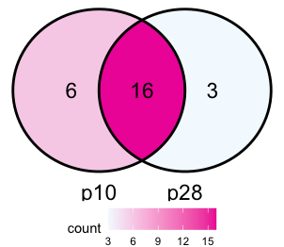

Introduction
Analysis & Results
Future work
Conclusion
Single-cell RNA-seq
LIANA
Functional Characterization
Sst ←→ Vip
Sst → Pvalb
Sst ←→ Pvalb
Pvalb → Sst
Interactions remains
Interactions remains

Slide 51

Introduction
Analysis & Results
Future work
Conclusion
Single-cell RNA-seq
LIANA
Functional Characterization
Notes:
Add the number of cells on top of each bar ?

Slide 52
Main results
Transient interactions across stages between Sst and Vip
Persistence interactions across stages between Sst and Pvalb
neurexins and neuroligins is substituted with GPCR pathway-associated L-R pairs for Sst and Vip interactions, with MAPK pathway are present in both.

Slide 53
Introduction
Analysis & Results
Future work
Conclusion
Single-cell RNA-seq
LIANA
Functional Characterization
Sst → Vip
Sst ←→ Vip
Strong interactions at p28
Sst ←→ Pvalb
Increasing interactions through development

Slide 54



Introduction
Analysis & Results
Future work
Conclusion
Single-cell RNA-seq
LIANA
Functional Characterization
P10
shared
P28
Sst → Vip
Sst ←→ Vip
Strong interactions at p28
Sst ←→ Pvalb
Increasing interactions through development

Slide 55



Introduction
Analysis & Results
Future work
Conclusion
Single-cell RNA-seq
LIANA
Functional Characterization
P10
shared
P28
Sst → Vip
Sst ←→ Vip
Strong interactions at p28
Sst ←→ Pvalb
Increasing interactions through development

Slide 56
Introduction
Analysis & Results
Future work
Conclusion
Single-cell RNA-seq
LIANA
Functional Characterization
Sst ←→ Vip
Vip → Sst
Strong interactions at p28
Sst ←→ Pvalb
Increasing interactions through development

Slide 57


Introduction
Analysis & Results
Future work
Conclusion
Single-cell RNA-seq
LIANA
Functional Characterization
P10
P28
Sst ←→ Vip
Vip → Sst
Strong interactions at p28
Sst ←→ Pvalb
Increasing interactions through development

Slide 58


Introduction
Analysis & Results
Future work
Conclusion
Single-cell RNA-seq
LIANA
Functional Characterization
P10
P28
Sst ←→ Vip
Vip → Sst
Strong interactions at p28
Sst ←→ Pvalb
Increasing interactions through development

Slide 59
Introduction
Analysis & Results
Future work
Conclusion
Single-cell RNA-seq
LIANA
Functional Characterization
Sst ←→ Vip
Sst → Pvalb
Sst ←→ Pvalb
Interactions remains

Slide 60



Introduction
Analysis & Results
Future work
Conclusion
Single-cell RNA-seq
LIANA
Functional Characterization
P10
shared
P28
Sst → Pvalb
Sst ←→ Pvalb
Interactions remains

Slide 61



Introduction
Analysis & Results
Future work
Conclusion
Single-cell RNA-seq
LIANA
Functional Characterization
P10
shared
P28
Sst → Pvalb
Sst ←→ Pvalb
Interactions remains

Slide 62
Introduction
Analysis & Results
Future work
Conclusion
Single-cell RNA-seq
LIANA
Functional Characterization
Sst ←→ Vip
Sst ←→ Pvalb
Pvalb → Sst
Interactions remains

Slide 63




Introduction
Analysis & Results
Future work
Conclusion
Single-cell RNA-seq
LIANA
Functional Characterization
P10
shared
P28
Sst ←→ Vip
Sst ←→ Pvalb
Pvalb → Sst
Interactions remains

Slide 64



Introduction
Analysis & Results
Future work
Conclusion
Single-cell RNA-seq
LIANA
Functional Characterization
P10
shared
P28
Sst ←→ Vip
Sst ←→ Pvalb
Pvalb → Sst
Interactions remains

Slide 65
Introduction
Analysis & Results
Future work
Conclusion
Single-cell RNA-seq
LIANA
Functional Characterization
Results summary
These observations provide a clear connection between the functional role of persistent versus transient neuronal subclass interactions.

Slide 66
Introduction
Analysis & Results
Future work
Conclusion
Investigate interactions between Excitatory vs. Inhibitory interneurons

Slide 67
Introduction
Analysis & Results
Future work
Conclusion
Investigate interactions between Excitatory vs. Inhibitory interneurons
How about other regions?
P10
P28

Slide 68

Introduction
Analysis & Results
Future work
Conclusion
Investigate interactions between Excitatory vs. Inhibitory interneurons
How about other regions?
Multi-omics? (LIANA+)
Integrate spatial data
bioRxiv preprint doi: https://doi.org/10.1101/2023.08.19.553863; this version posted August 21, 2023

Slide 69
Introduction
Analysis & Results
Future work
Conclusion
Investigate interactions between Excitatory vs. Inhibitory interneurons
How about other regions?
Multi-omics? (LIANA+)
Integrate spatial data
Metabolite-mediated pathways
bioRxiv preprint doi: https://doi.org/10.1101/2023.08.19.553863; this version posted August 21, 2023

Slide 70
Introduction
Analysis & Results
Future work
Conclusion
A
Sst → Vip
Vip → Sst
B
Sst → Pvalb
Pvalb → Sst

Slide 71
Questions???

Slide 72
Structure of presentation
Introduce the paper
(Brief) Overview of background and dataset
CCC analysis: LIANA
Basic concepts
Methods and resources
Packages/Functions
Analysis & results
Workflow (pipeline)
scRNA-seq (mention, but maybe not in detail)
QC matrices
Inferring interactions: LIANA
Outputs of Liana
Directions
Bootstrapping (robust interactions)
Plotting
How to improve?
Consider spatial data (LIANA+)
Consider other omics? (metabolite-mediated pathways)
Conclusion

